Slide 1
The causes, impacts and countermeasures of COVID-19 “Infodemic”- A systematic review using narrative synthesis

Slide 2
Introduction
The definition of info-demic:
The term infodemic was coined in 2003 by David Rothkopf, a writer for Washington Post (Rothkopf, 11 May 2003). It has different definitions, varying from "a few facts, mixed with fear, speculation, and rumor, amplified and relayed swiftly worldwide by modern information technologies" to "a rapid and far-reaching spread of both accurate and inaccurate information about something, such as a disease" by Merriam-Webster dictionary.
The Objective of this article:
1) synthesize the existing literature on the causes and impacts of COVID-19 infodemic;
2) summarize the proposed countermeasures to fight with COVID-19 infodemic;
3) identify the directions for future research.

Slide 3
Introduction
The behind reason of info-demic.
Social media usage and low level of health/eHealth literacy were major causes of the info-demic.
Fast publication process and preprint service were possible causes.
The vicious circle of human rumor-spreading behavior that fed psychological stresses of public social media users (e.g., anxiety, distress, fear) emerged as a dominant characteristic of the infodemic,which was not investigated in previous studies

Slide 4
Method
1. PRISMA guideline:
Twelve databases :
2.Query :
1.(infodemic OR infodemiology) OR
2. OR (COVID-19 OR SAR-COV-2 OR coronavirus)
3. AND (misinformation OR rumor OR rumour OR disinformation OR conspiracy theory OR fake news))"

Slide 5
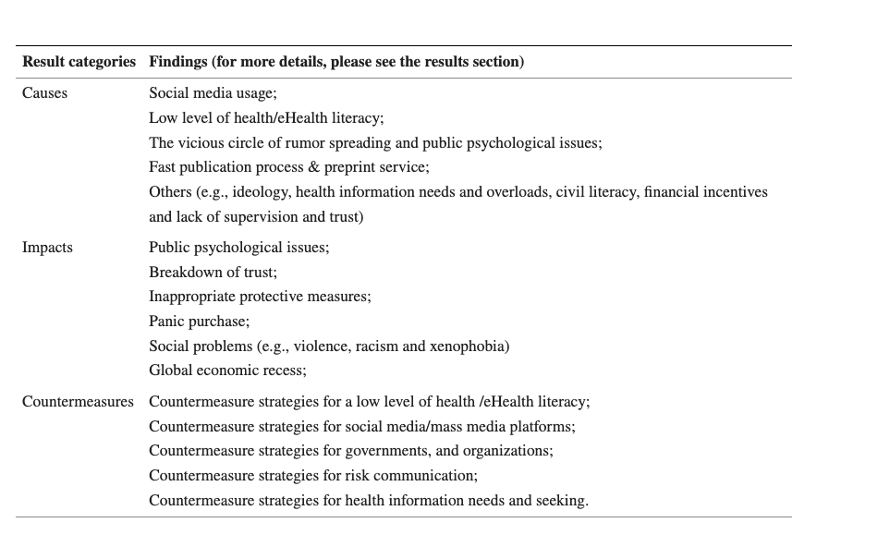
Results

Slide 6
Implications
1. the psychological well-being of the public and their beliefs should be taken care of simultaneously.
2. a large group of concrete recommendations exist for risk communication.
different framing strategies should be considered for different groups of people as they may be only sensitive to particular messaging styles
3. multidisciplinary perspective should be taken to provide tailored health information for different groups of people, considering not only the customization of content but also the communication strategies.

Slide 7
Advantages
1,Integrating multiple articles, including the causes, effects, and countermeasures of COVID-10
2. fast publication process and preprint service are listed in the article for the first time.
3. the interaction with rumor-spreading and the psychological issues

Slide 8
Research limitations
1. only limited to covid-19 the case perspective, the resulting theory needs further testing
2. no data support, only some theoretical expansion.
3. the validity of the sampling needs to be verified
4. the emergence of rumor-spreading and public psychological problems suggests a link between the two, but for the survey, it was conducted separately.
5, the Implications were not validated
6.Only articles in English were researched, but no other languages were validated.

